Slide 1
The True Meaning of “Decision Day”
Edward Gates, Jr.
Philip Nunoo
Nikita Jones
Mason Waters

Slide 2
Agenda
Introduction
The Why?
Data Exploration & Clean-Up
Analysis
Undergraduate Major
Region
School Type
Conclusions

Slide 3
Introduction
We are seeking to help students choose what college they’d attend if a higher salary was their only concern.
Our project will analyze and compare the Starting, Mid-career, and Mid-career 90th percentile salaries
Questions
For higher income :
What should my major be?
Which region should I attend college?
What type of college should I attend?

Slide 4

THE WHY?
Decision Day!

Slide 5
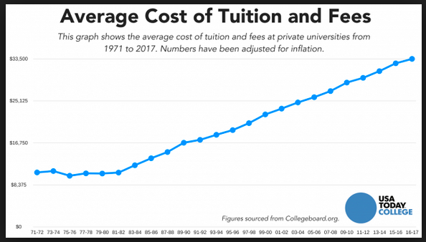
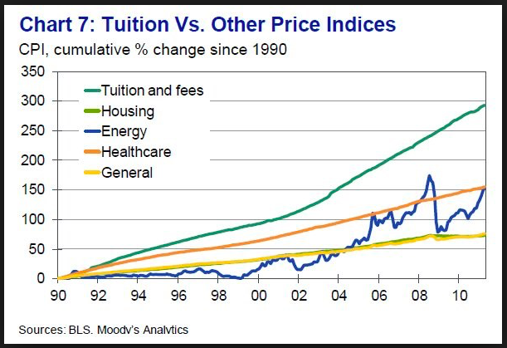
Tuition & Fees vs. Other Indices

Slide 6
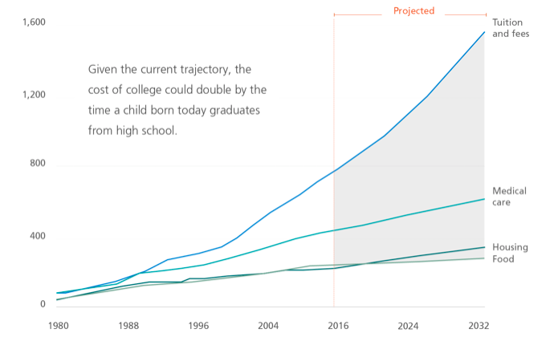
Tuition & Fees vs. Other Indices

Slide 7
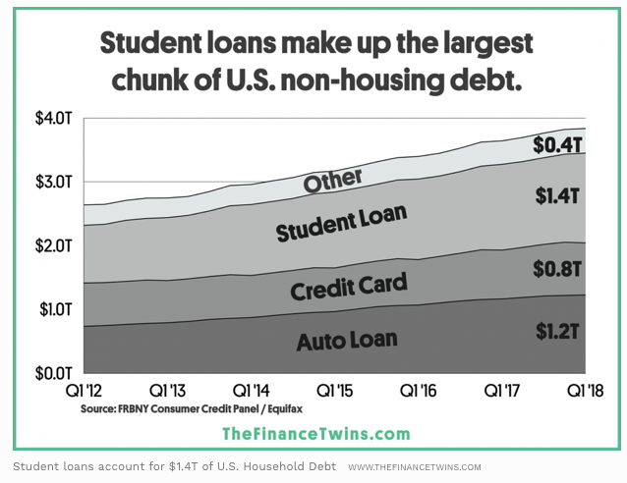
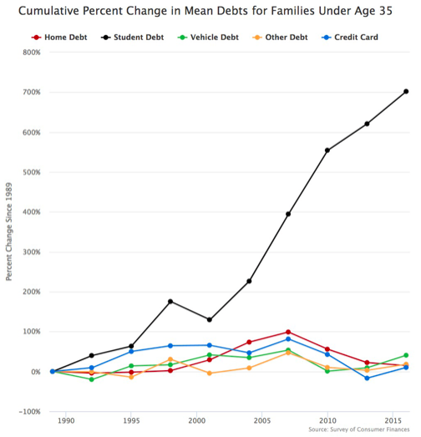
Student loans vs U.S Non-Housing Debt
40%

Slide 8

DATA EXPLORATION & CLEAN-UP
Decision Day!

Slide 9
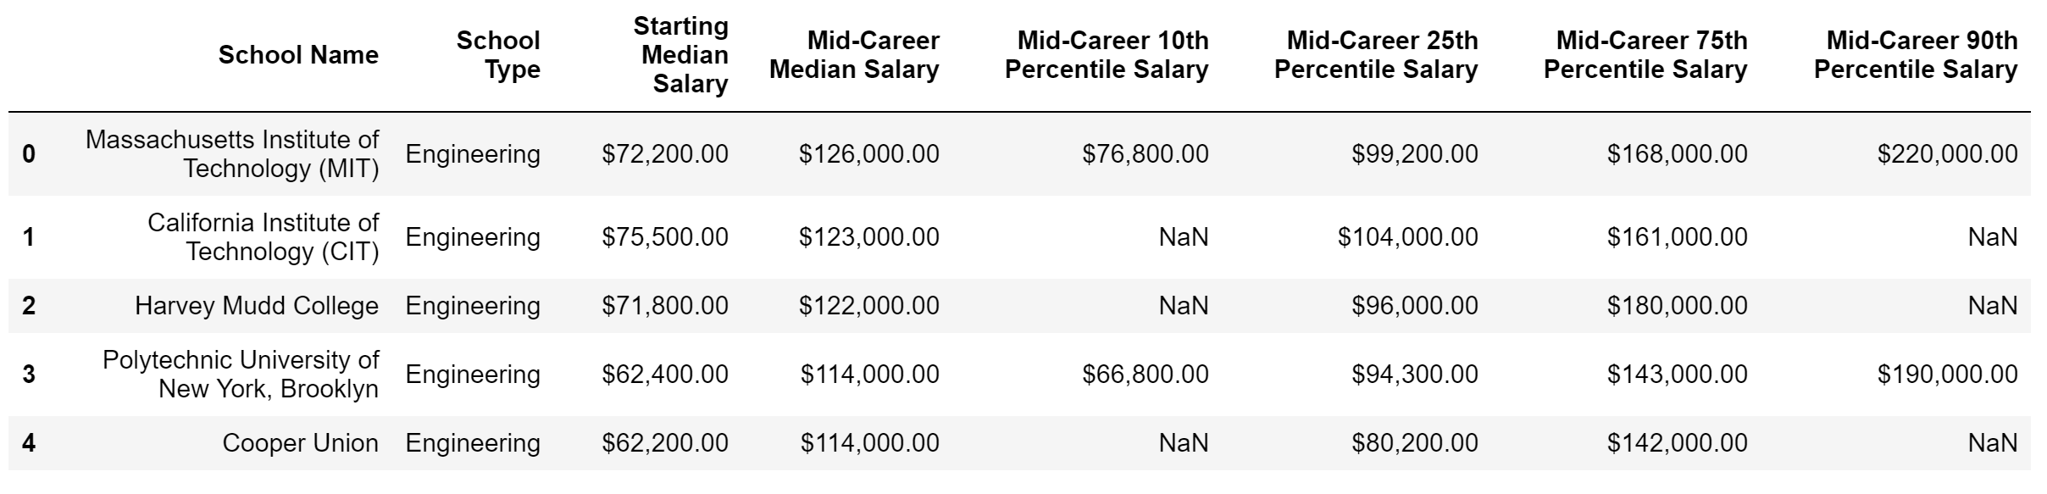
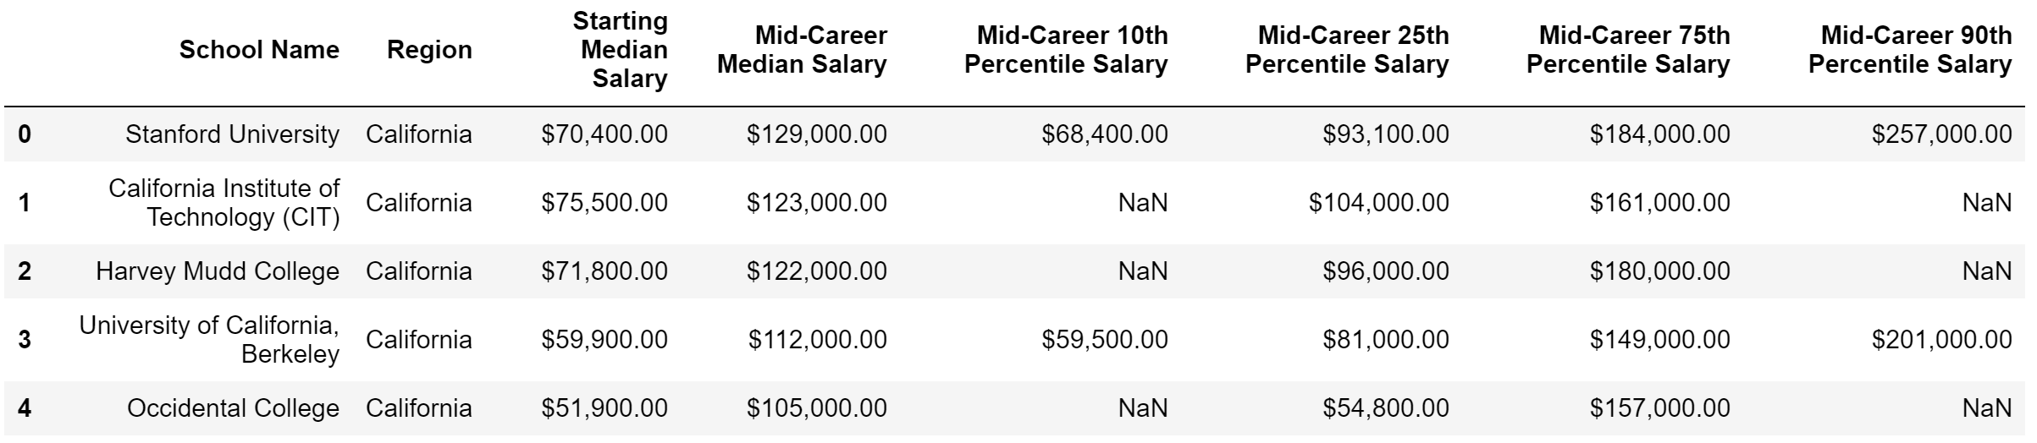
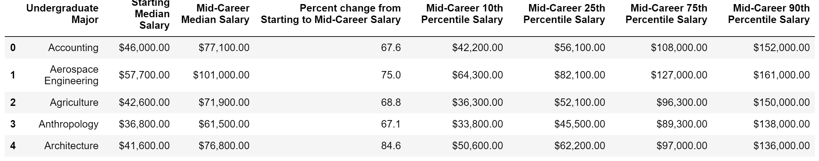
Data Exploration & Clean-Up
School Type
Region
Major

Slide 10
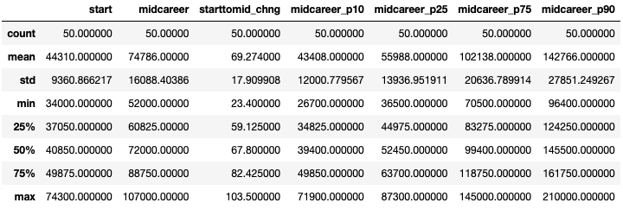
Overall Descriptive Statistics – Undergraduate Major

Slide 11
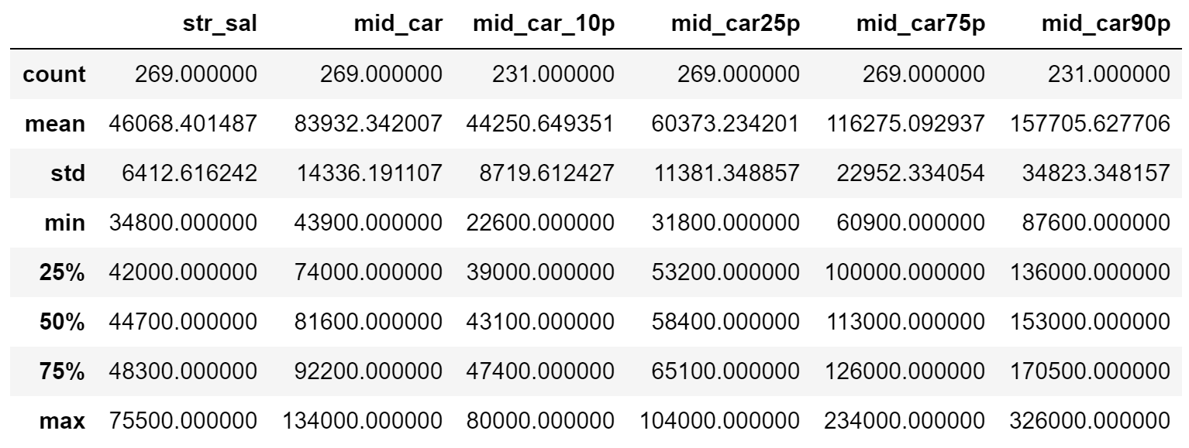
Overall Descriptive Statistics – School Type

Slide 12
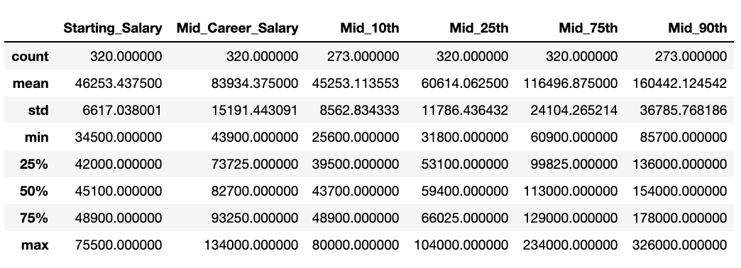
Overall Descriptive Statistics – Region

Slide 13

DATA ANALYSIS: MAJOR
Decision Day!

Slide 14
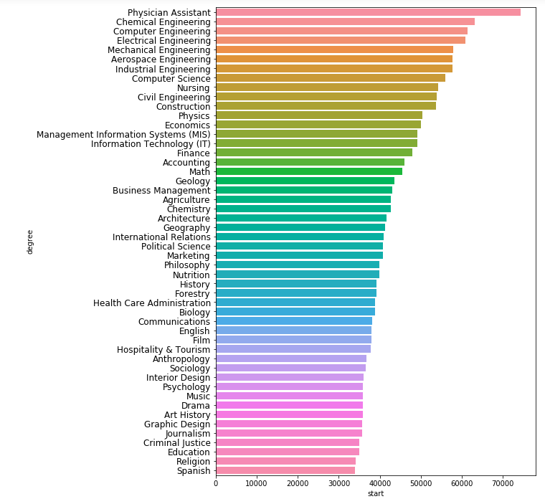
Which Undergraduate Majors get the highest income at the start of their careers?
Top 5
Physician Assistant: $74,300
Chemical Engineering: $63,200
Computer Engineering: $61,400
Electrical Engineering: $60,900
Mechanical Engineering: $57,900
Bottom 5
Spanish: $34,000
Religion: $34,100
Education: $34,900
Criminal Justice: $35,000
Journalism: $35,600

Slide 15
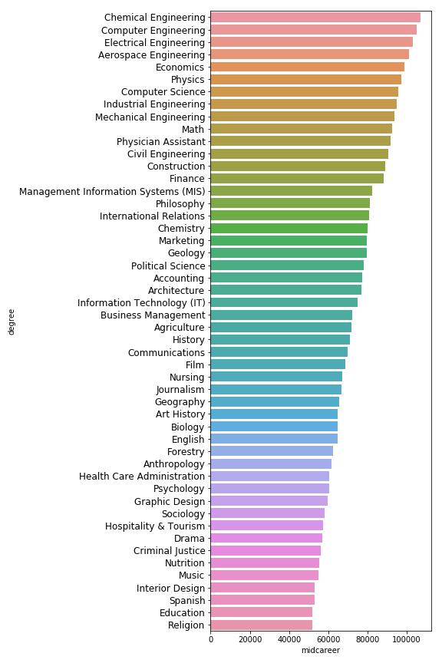
Which Undergraduate Majors get the highest income at Mid-Career?
Top 5
Chemical Engineering: $107,000
Computer Engineering: $105,000
Electrical Engineering: $103,000
Aerospace Engineering: $101,000
Economics: $98,600
Bottom 5
Religion: $52,000
Education: $52,000
Spanish: $53,100
Interior Design: $53,200
Music: $55,000

Slide 16
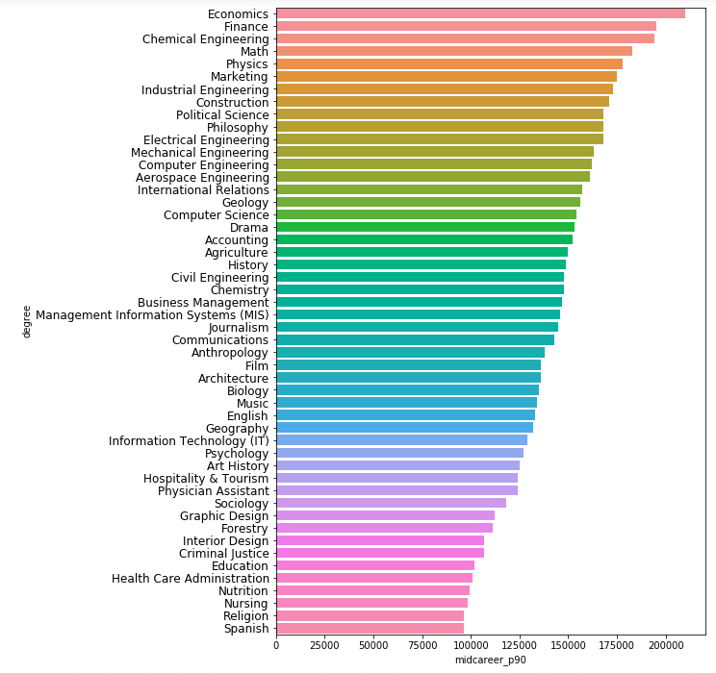
Which Undergraduate Majors get the highest income at Mid-Career 90th Percentile?
Top 5
Economics: $210,000
Finance: $195,000
Chemical Engineering: $194,000
Math: $183,000
Physics: $178,000
Bottom 5
Spanish: $96,400
Religion: $96,400
Nursing: $98,300
Nutrition: $99,200
Healthcare Administration: $101,000

Slide 17
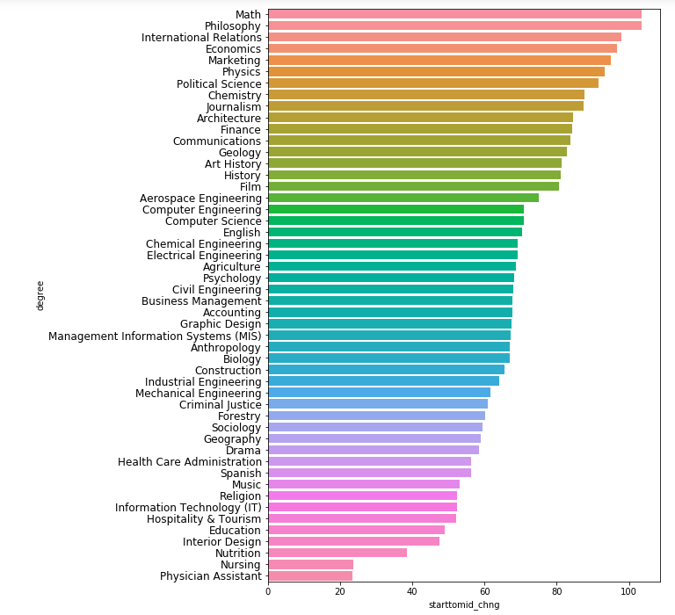
Percent change from Starting to Mid-Career Salary
Top 5
Math: 103.5%
Philosophy: 103.5%
Economics: 97.8%
Marketing: 96.8%
Physics: 95.1%
Bottom 5
Physician Assistant: 23.4%
Nursing: 23.4%
Nutrition: 38.6%
Interior Design: 47.4%
Education: 49%

Slide 18
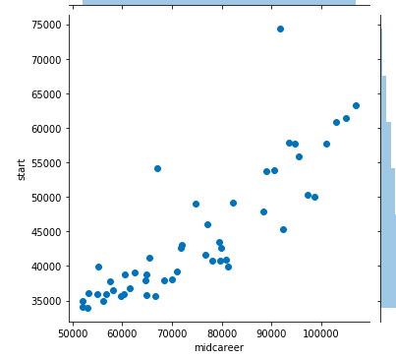
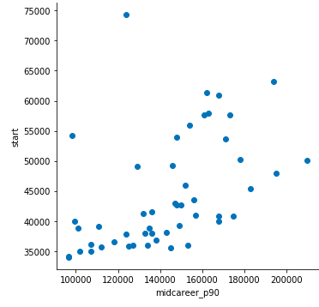
Starting Salary: Mid-Career vs. Mid-Career 90th
Pearson Correlation: 0.85
Pearson Correlation: 0.70

Slide 19
Majors Summary
Physician Assistants start their career with the highest salary but salary growth to mid-career is at only 23%.
At mid-career, Chemical, Computer, and Electrical Engineers get the highest salaries.
A look at the top 10% mid-career earners show that Economics, Math, and Chemical Engineering majors earn the highest possible incomes of all.
Math and Philosophy majors tend to have the largest increase in their salary during their career.
With a choice of degree and only concerned about higher salary, we encourage students to major in STEM.

Slide 20
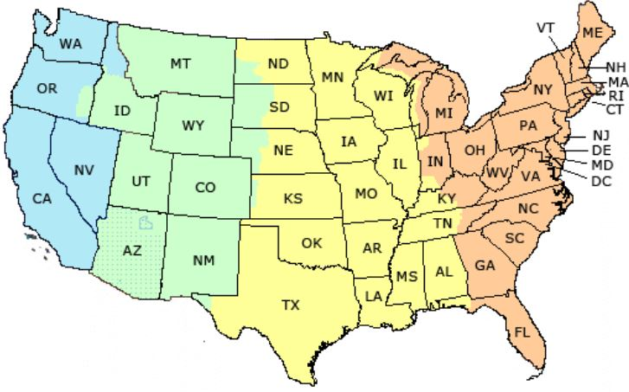
DATA ANALYSIS: REGION
Decision Day!

Slide 21
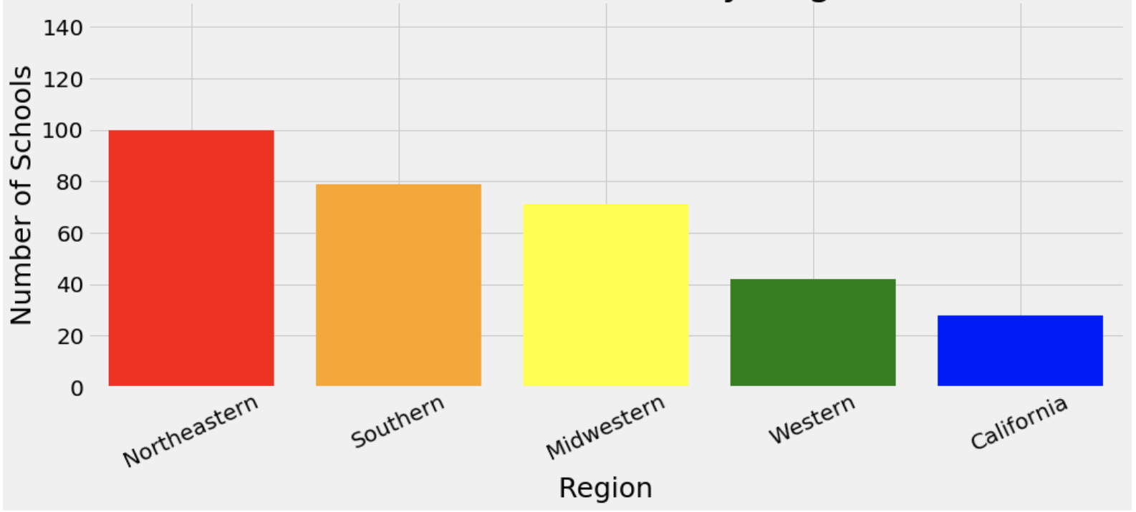
Number of Schools Per Region
CALIFORNIA | 28
WESTERN | 42
MIDWESTERN | 71
SOUTHERN | 79
NORTHEASTERN | 100

Slide 22
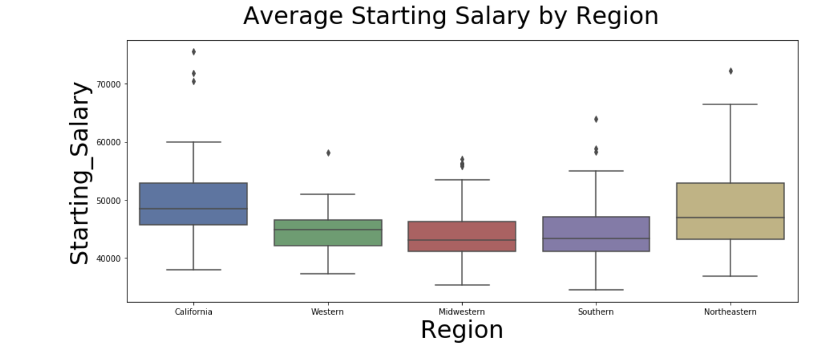
Median Starting Salary
REGION RANKING
California
Northeastern
Southern
Western
Midwestern
p-value=0.938
Fail to reject
p-value=0.938
Fail to reject
Notes:
Now that we have an idea of which major would bring about more financial gain, we are going to introduce the regions that produce the highest salaries. We have five regions and we wanted to compare the range of starting-salaries, mid-salaries, and top earner salaries across theses groups. Boxplots were used to compare the dispersion of salaries among the regions. Based upon our boxplots there appears to be similarities between the highest earning regions and similarities among lowest earning regions. A T-test was used for the top two regions. The ANOVA test was used for the bottom three regions. Both tests failed to reject the Null Hypothesis for starting Salaries. The tests suggested that highest earning regions were similar at the starting salary; and the lower earners are similar
Western/Midwestern/Southern
statistic=0.064, pvalue=0.938 (High pvalue = fail to reject)
Fail to reject the null, the means for those 3 are similar (No difference by region)
California/Northeastern
statistic=1.38, pvalue=0.177 (High pvalue = fail to reject)
Fail to reject the null, the means for those 2 are similar (No difference by region)

Slide 23
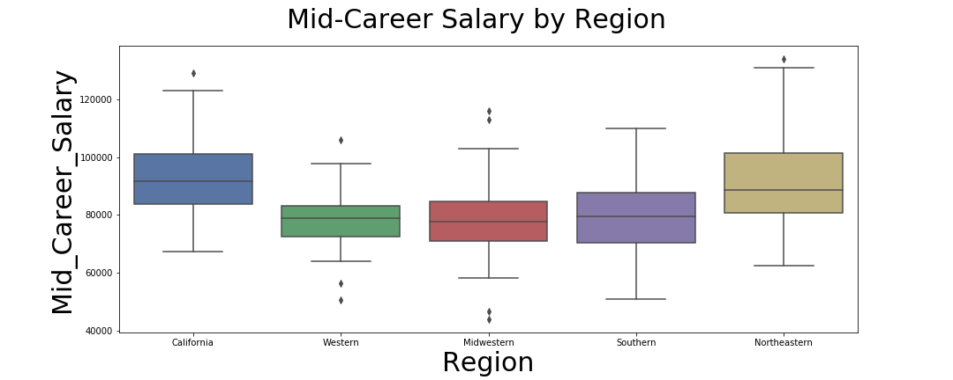
Mid-Career Salary
REGION RANKING
California
Northeastern
Midwestern/Southern
Western
p-value=0.001
Reject the null
p-value=0.59
Fail to reject
Notes:
After 10 years in their careers, they were still the lowest earning regions. Pertaining to California and the Northeastern regions, they started their careers earning higher salaries and after 10 years in, they remained the top two earning regions
Western/Midwestern/Southern
statistic=17.13, pvalue= ~0.0001 (low pvalue = reject NH)
Reject the null, the means for those 3 are different
California/Northeastern
statistic=0.53, pvalue=0.59 (High pvalue = fail to reject)
Fail to reject the null, the implies for those 2 are similar (No difference by region)

Slide 24
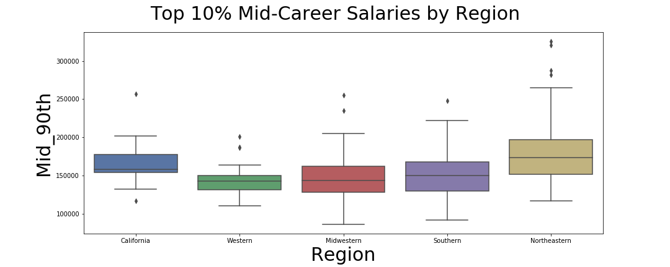
Top 10% Mid-Career Salaries
REGION RANKING
Northeastern
California
Southern
Midwestern
Western
p-value=0.083
Fail to reject
p-value=0.30
Fail to reject
Notes:
California and the Northeastern were also the regions with the highest earners in the top 10% of the wealthy.
What should you do if you’re motivated by money? Attend a college or university in the California or Northeast region.
During the T-test for the to 10% of earners during mid-career, our results were outside of the normal distribution, rejecting the Null Hypothesis. Therefore, there is a significant difference in Starting Salary and Mid Career Salaries based upon region.
Western/Midwestern/Southern
statistic=1.20, pvalue=0.30 (High pvalue = fail to reject)
Fail to reject the null, the means for those 3 are similar (No difference by region)
Western/Midwestern/Southern
statistic=1.20, pvalue=0.30 (High pvalue = fail to reject)
Fail to reject the null, the means for those 3 are similar (No difference by region)

Slide 25
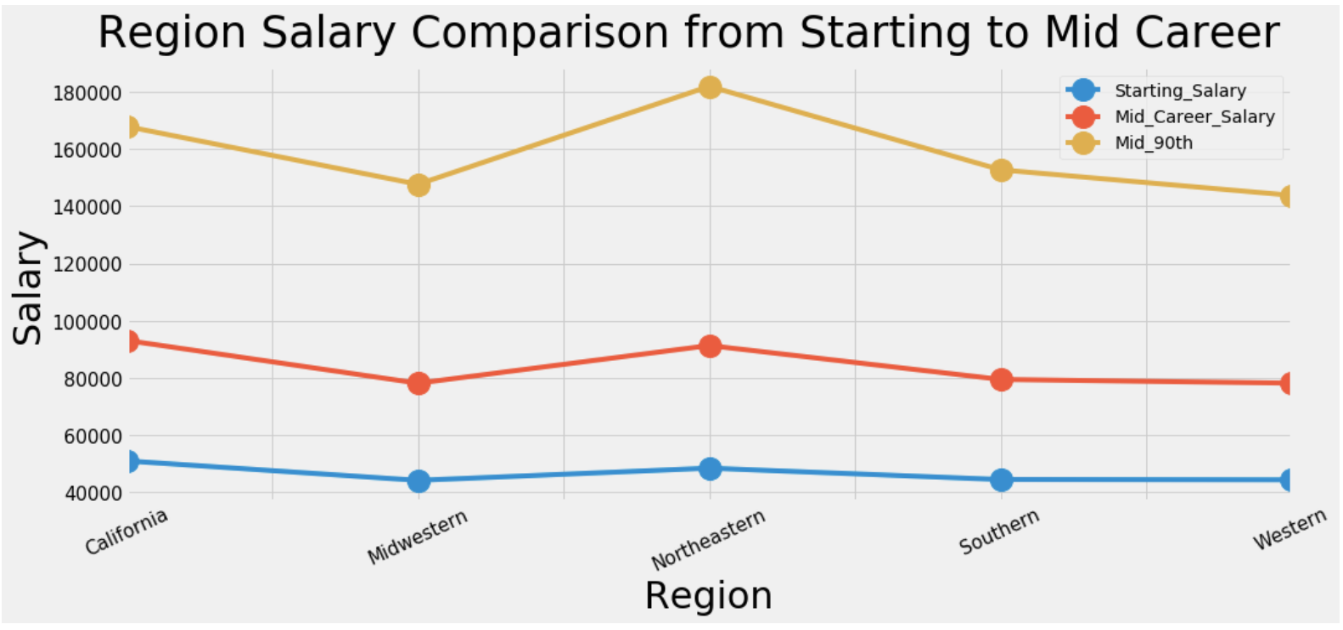
Summary of Salary by Region

Slide 26
Region Majors Summary
California accounted for less than 9% of schools; started careers with highest mean salary; maintained the highest mean salary at mid-career; ranked second highest 90th percentile earners at mid-career.
Northeastern accounted for 30% of the schools; started careers with second highest mean salary; maintained second highest at mid-career; ranked highest 90th percentile earners at mid-career.
California and Northeastern had the most similar and significant earning salaries at the top 10% of mid-career.
Western region (13% of schools) had the fewest schools, the lowest earnings, and smallest percentage of salary growth from start to mid-career of all regions.
If selecting a region for school choice based upon potential salary, California and the Northeastern regions are the highest earners.
Notes:
Southern(24% of schools), Western , and Midwestern(22% of schools) started as the lowest earning regions and remained the lowest earners at mid-career.

Slide 27



DATA ANALYSIS: SCHOOL TYPE
Decision Day!

Slide 28
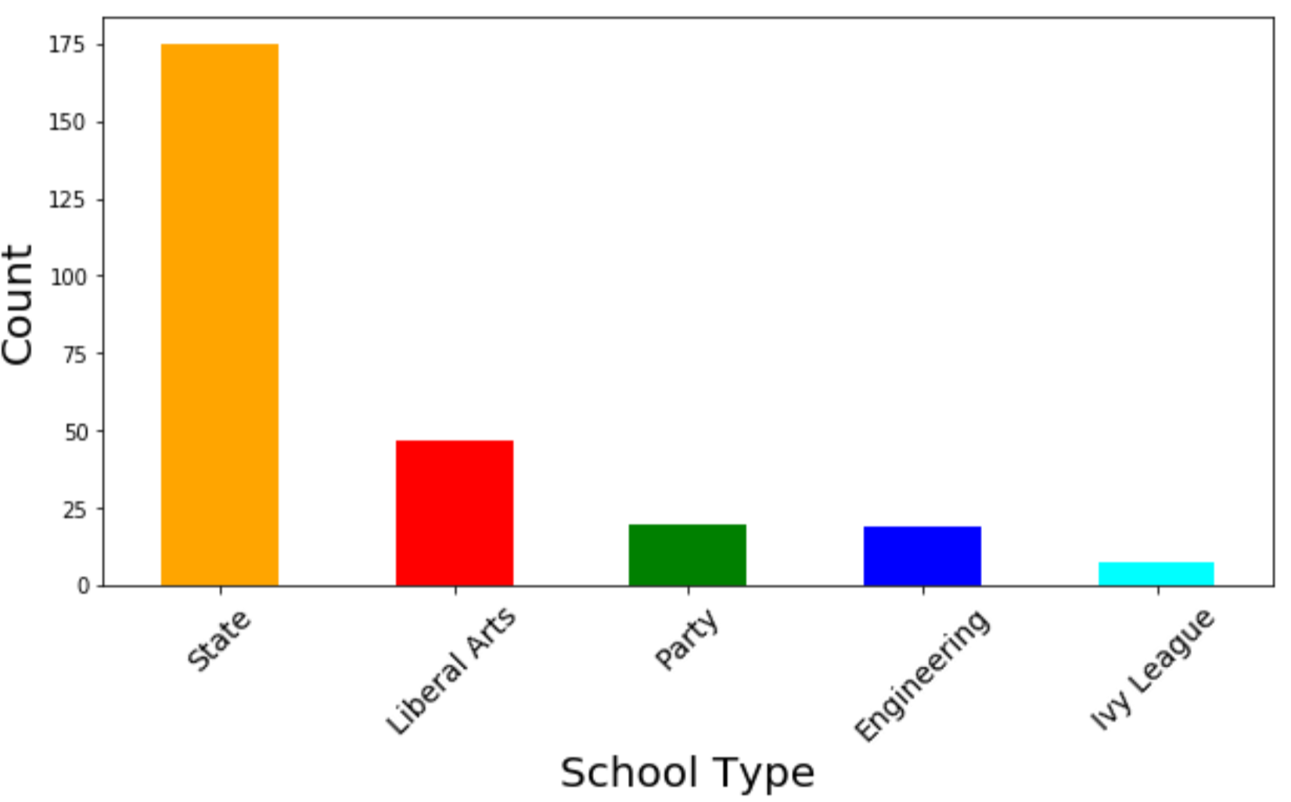
Number of Schools Per School Type
STATE | 175
LIBERAL ARTS | 47
PARTY | 20
ENGINEERING | 19
IVY LEAGUE | 8

Slide 29
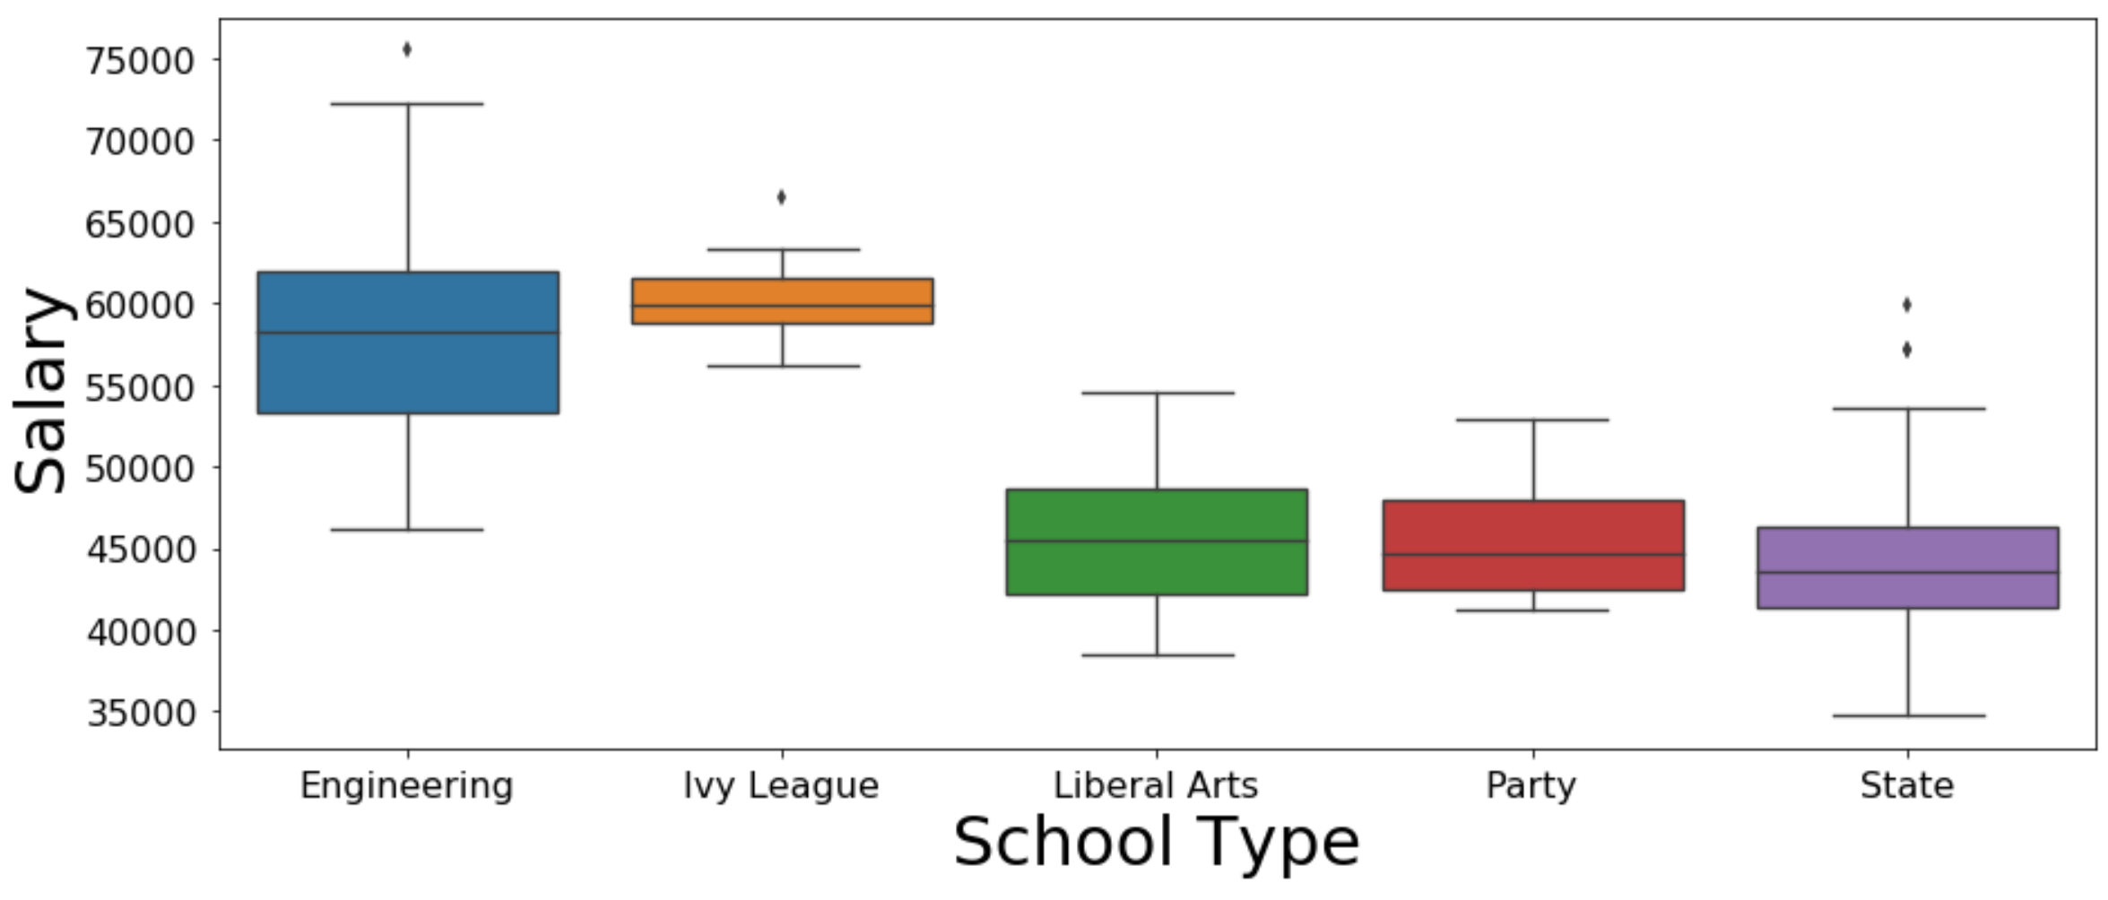
Distribution of Starting Salary by School Type
COLLEGE TYPE RANKING
Ivy League
Engineering
Liberal Arts
Party
State
p-value=0.511
Fail to reject
p-value=0.032
Reject
Notes:
We used boxplots to compare the starting salary of each school type. By looking at the boxplot, we discovered that engineering and Ivy league schools starting salaries could be similar. We then conducted a T-test to determine if there was a similarity between them. After performing the test, we got a p-value of 0.511 failing to reject the null showing that there are similarities. We also noticed that liberal arts, party, and state schools might have similar starting salaries. We conducted an ANOVA test to determine if there was a similarity between them. After performing the analysis, we got a p-value of 0.032 rejecting the null.

Slide 30
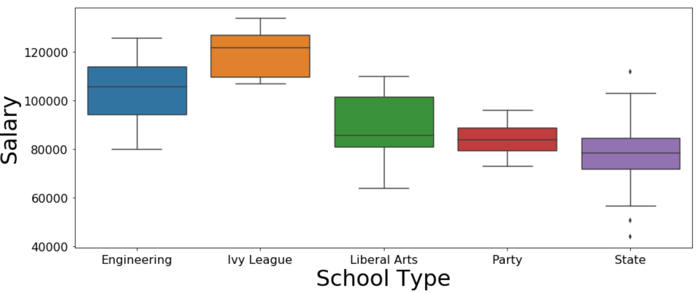
Distribution of Mid-Career Salary by School Type
COLLEGE TYPE RANKING
Ivy League
Engineering
Liberal Arts
Party
State
Notes:
We created a boxplot to compare the mid-career salary of each school type. By looking at the boxplot, we discovered that engineering and Ivy league schools starting salaries could be similar but are farther apart from starting salary. We then conducted a T-test to determine if there was a similarity between them. After performing the test, we got a p-value of 0.003 rejecting the null, unlike the starting salary. We also noticed that liberal arts, party, and state schools might have similar mid-career salaries. We conducted an ANOVA test to determine if there was a similarity between them. After performing the analysis, we got a very low p-value rejecting the null.

Slide 31
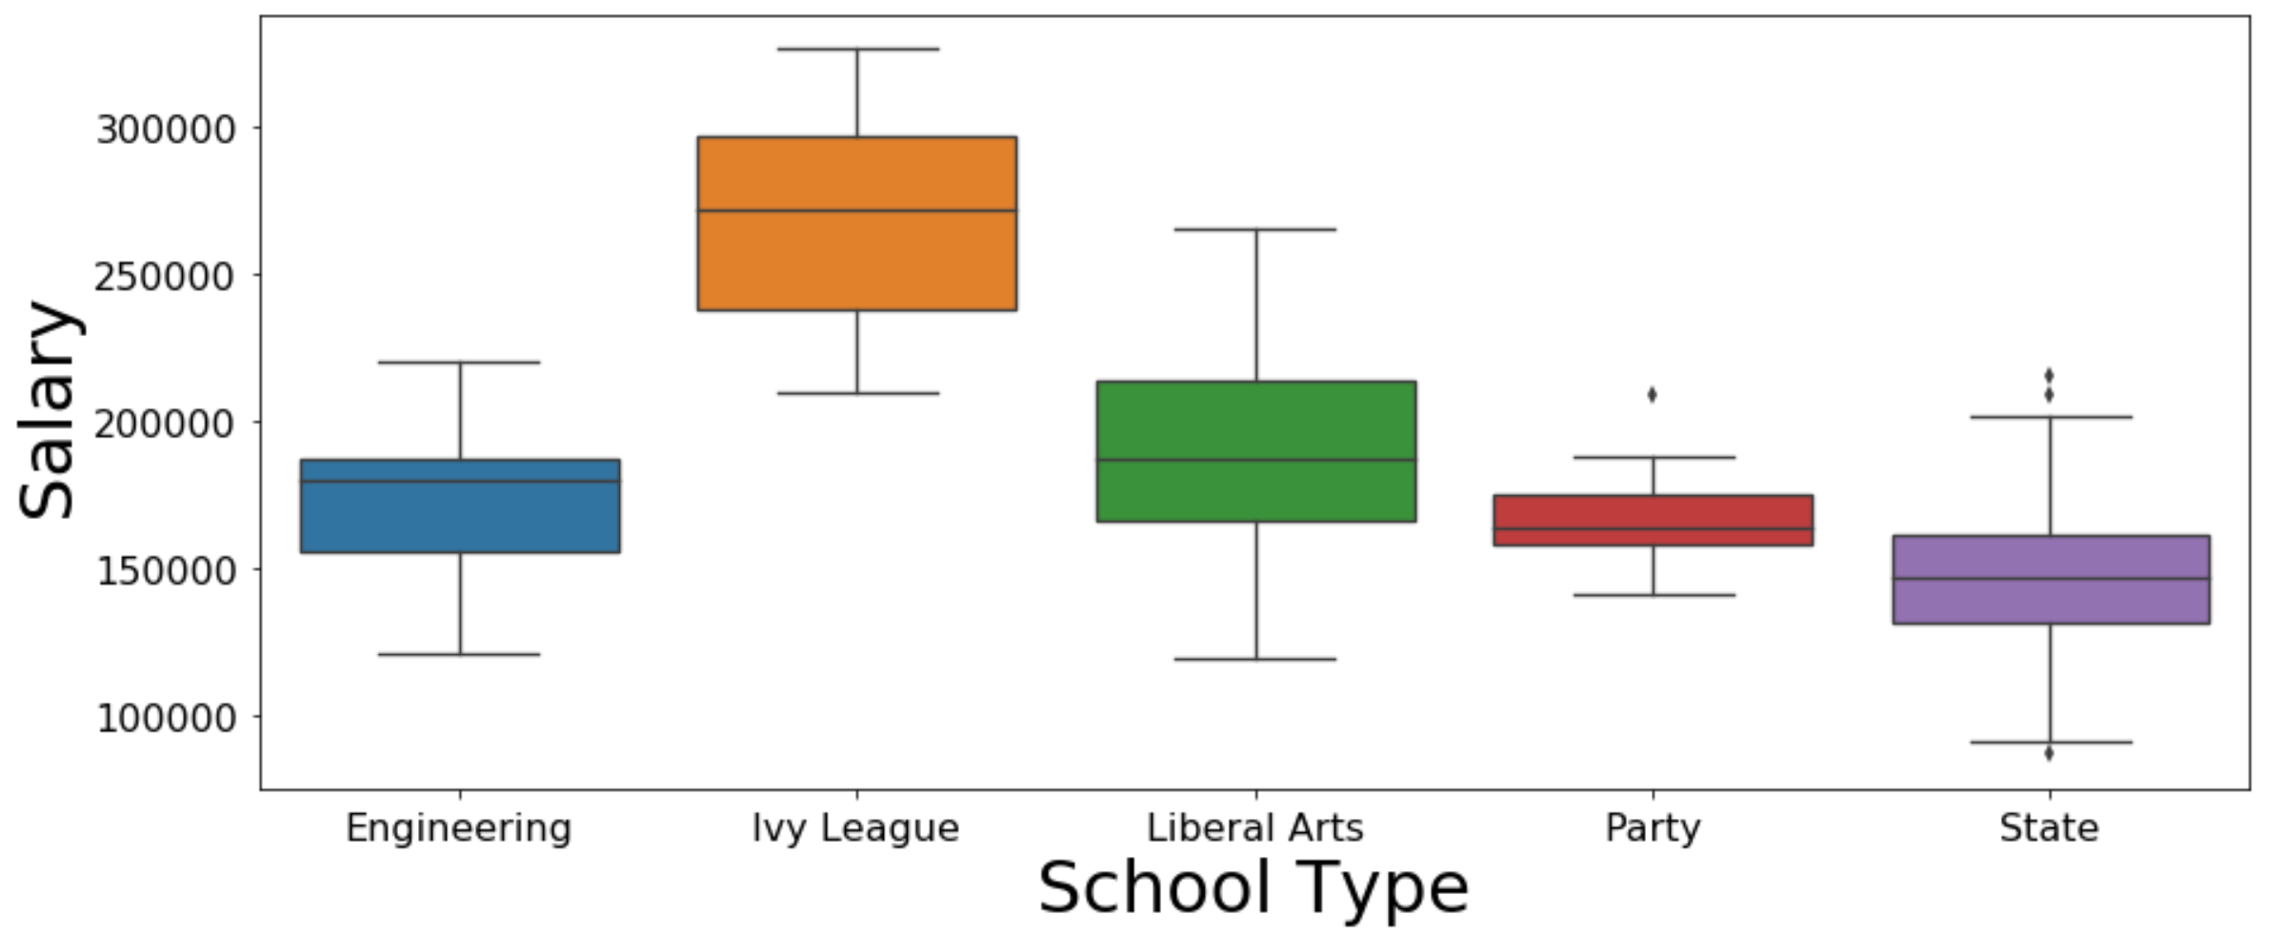
Distribution of Mid-Career 90th Salary by School Type
TYPE SALARY RANKING
Ivy League
Liberal Arts
Engineering
Party
State

Slide 32
School Type Summary
State schools count for ⅔ of all school types.
Engineering and Ivy League schools have similar and the most significant starting salaries.
Engineering and Ivy League schools held their top positions until engineering saw a drop in the mid-career 90th percentile.
In the long term, attending an Ivy league school showed the most significant salary advantage.
State schools showed the lowest long term salary advantage.
As a result, we encourage students to attend Ivy league or Engineering Schools.

Slide 33
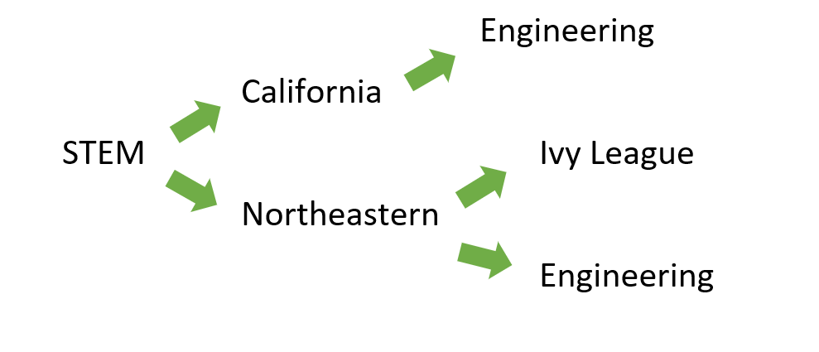
Conclusions
For higher income…
Construction, Information Technology, Political Science, Philosopy, Finance

Slide 34
?
Any questions?
?
?

